Slide 1
Buffer overflow

Slide 2
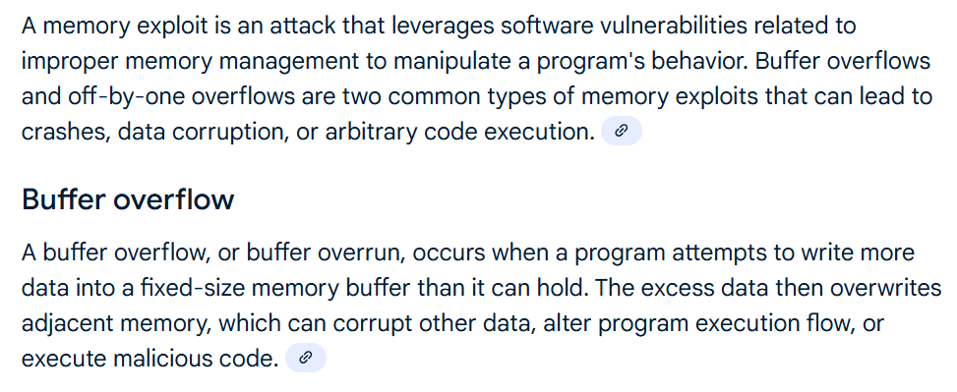
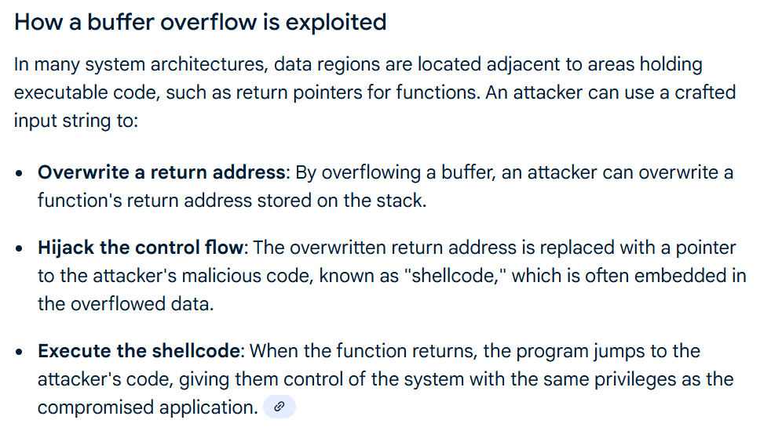

Slide 3
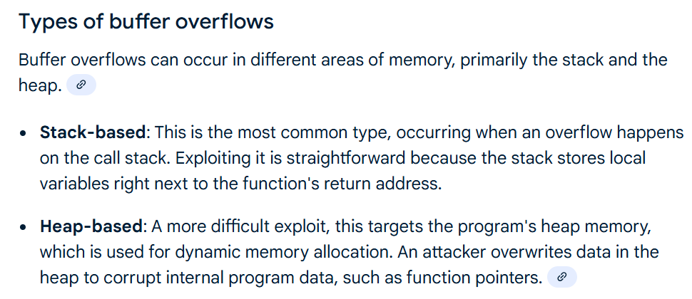

Slide 4
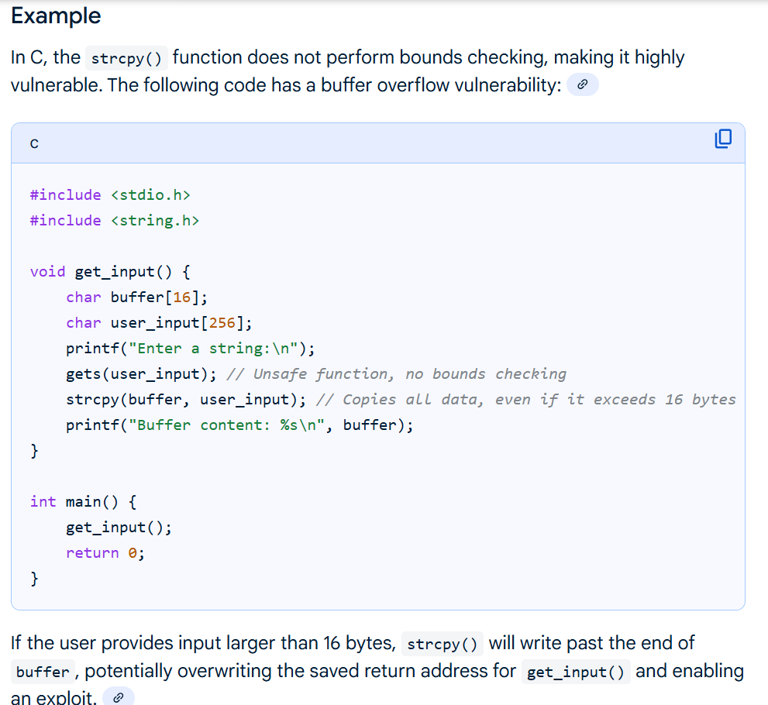

Slide 5
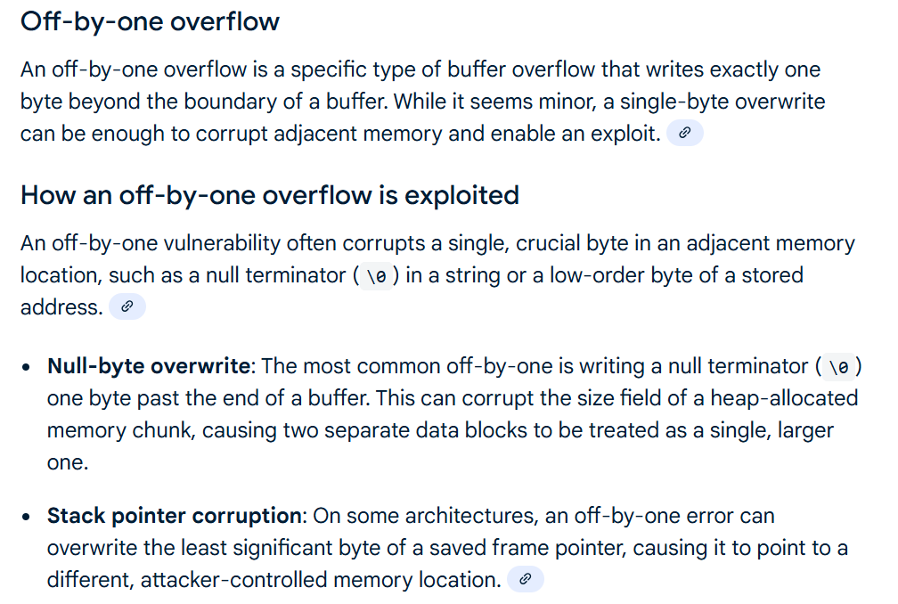

Slide 6
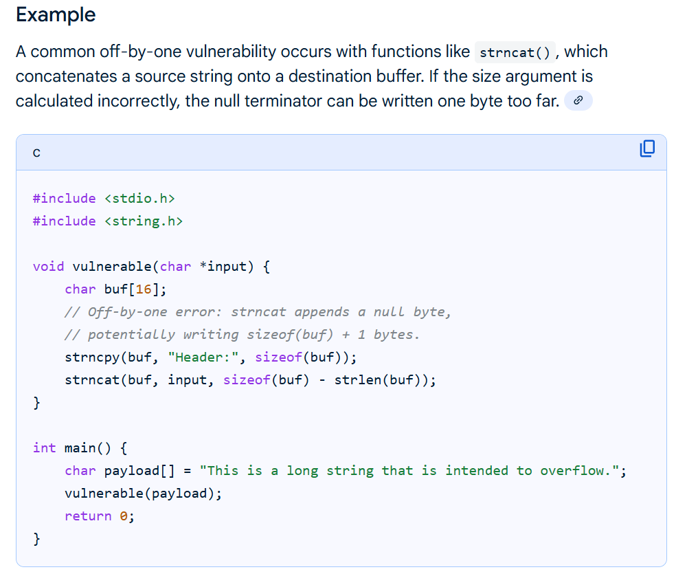

Slide 7
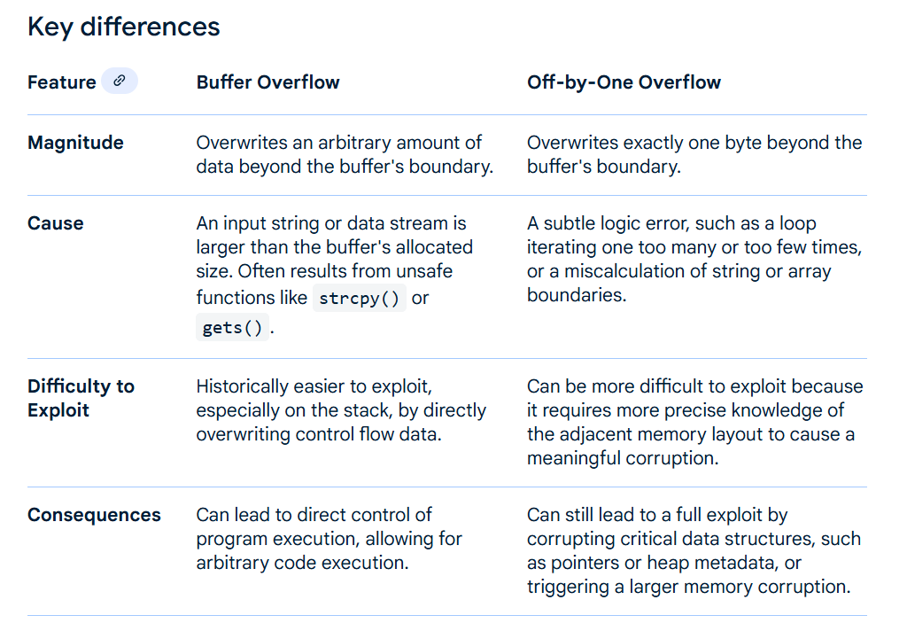

Slide 8
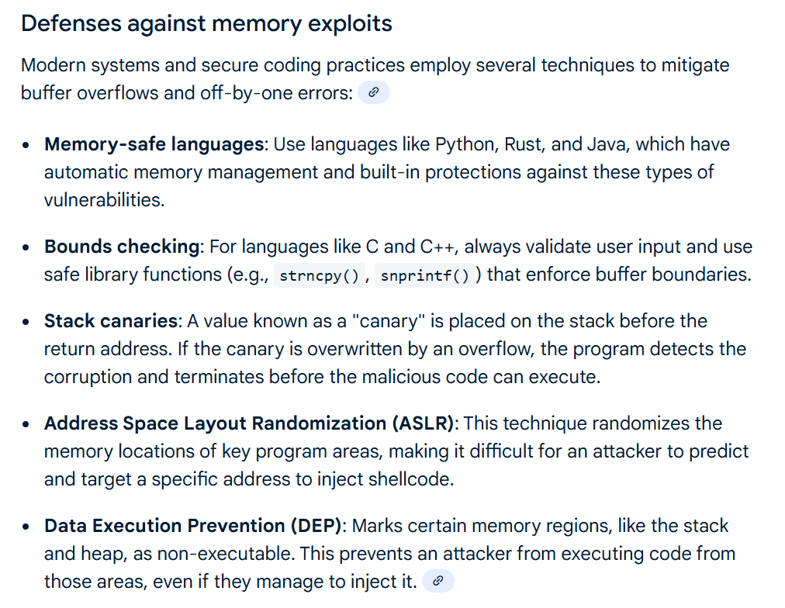

Slide 9
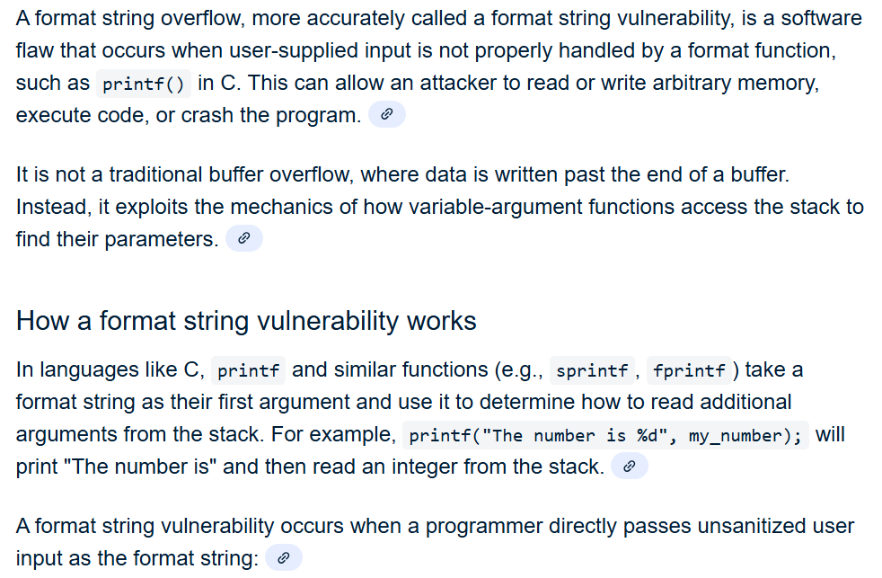
Format string attack

Slide 10
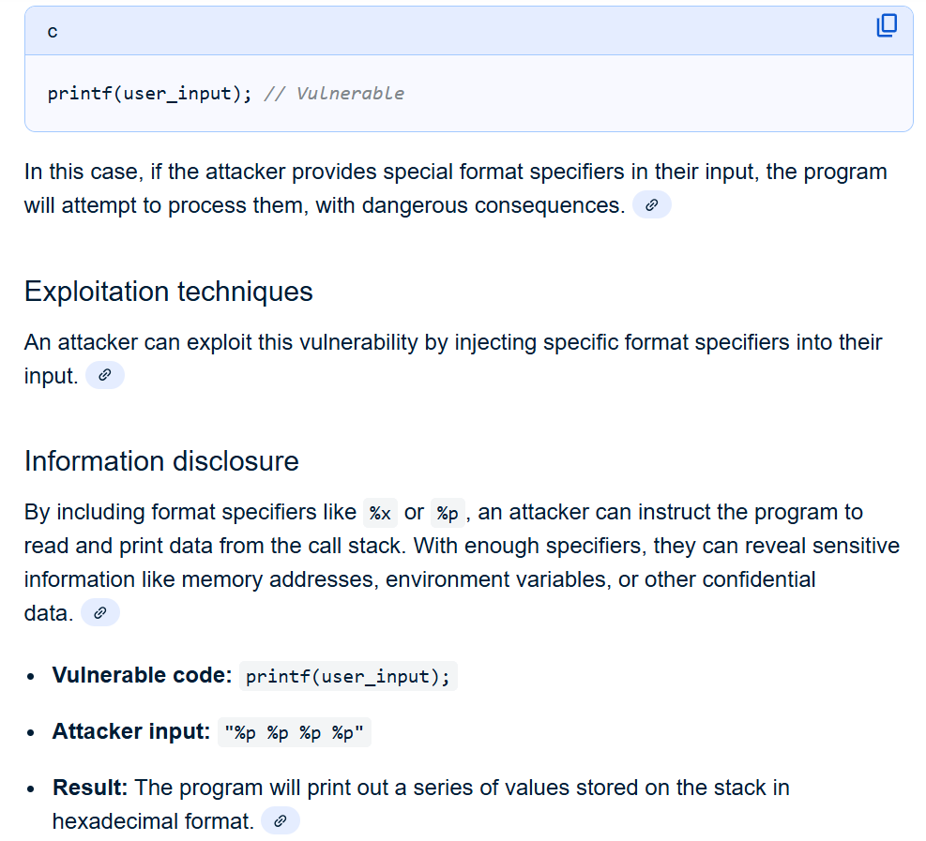

Slide 11
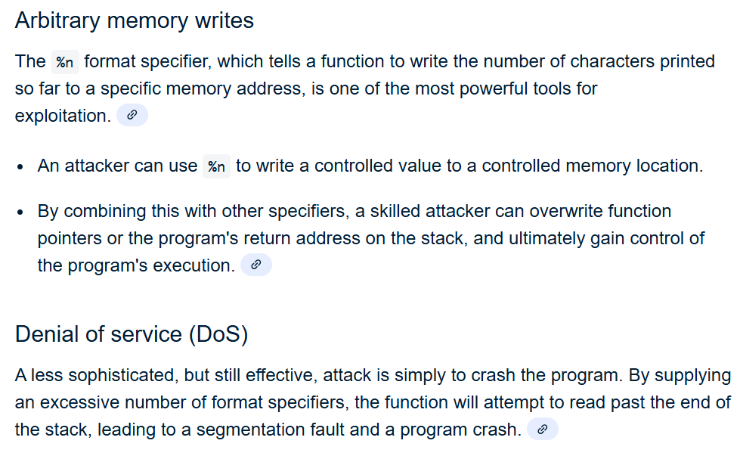

Slide 12
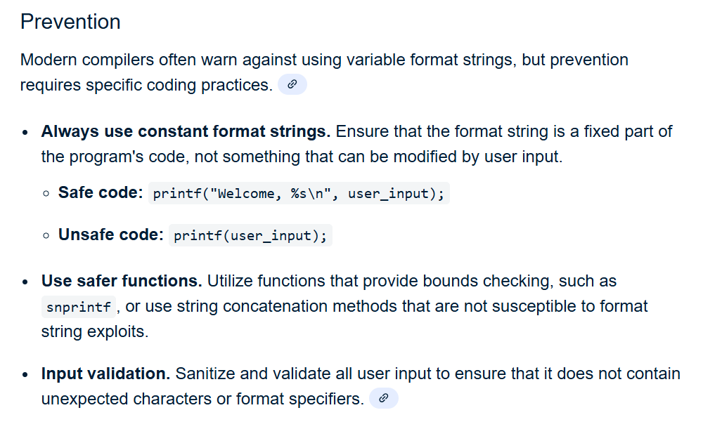

Slide 13
Integer Overflow
An integer overflow is a programming error that occurs when an arithmetic operation produces a result larger than the maximum value that an integer data type can hold. Instead of throwing an error, the value often "wraps around" to the minimum value (or a negative value) or causes undefined behavior, which can lead to incorrect results, system instability, and security vulnerabilities, such as buffer overflows.
An integer overflow is a type of an arithmetic overflow error when the result of an integer operation does not fit within the allocated memory space. Instead of an error in the program, it usually causes the result to be unexpected. Integer overflows have been listed as the number 8 most dangerous software error in the most recent CWE 2019 list, mostly because they often lead to buffer overflows, which are currently the number 1 most dangerous software error according to that list.

Slide 14
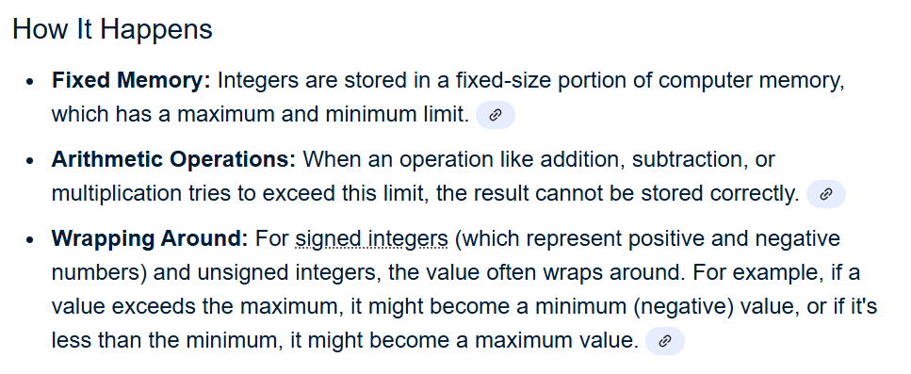

Slide 15
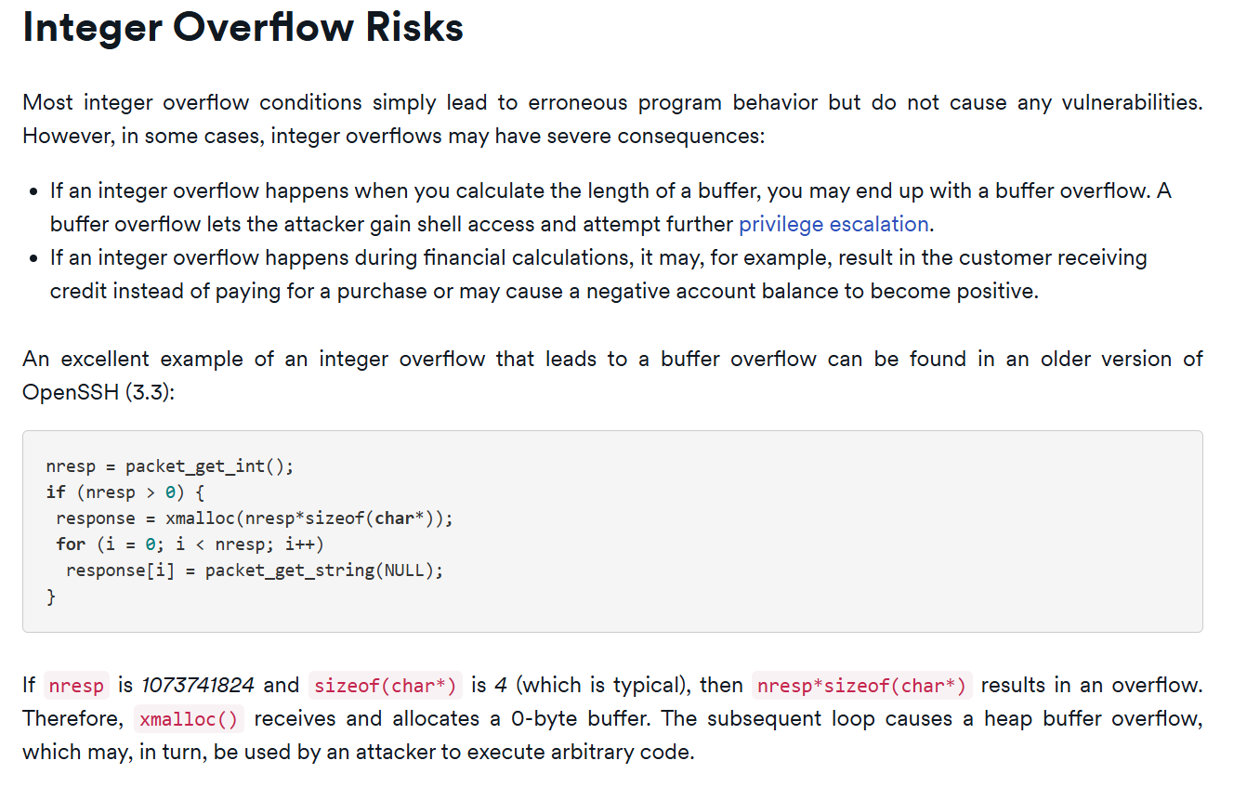

Slide 16
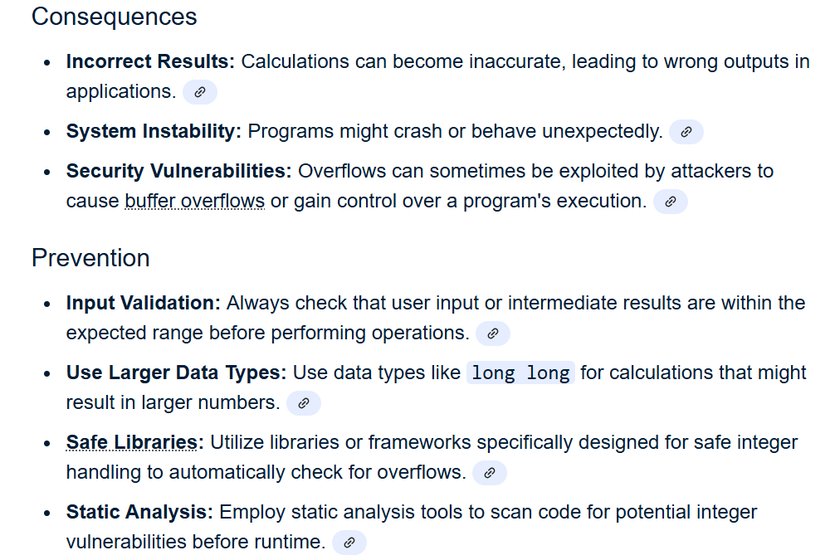

Slide 17
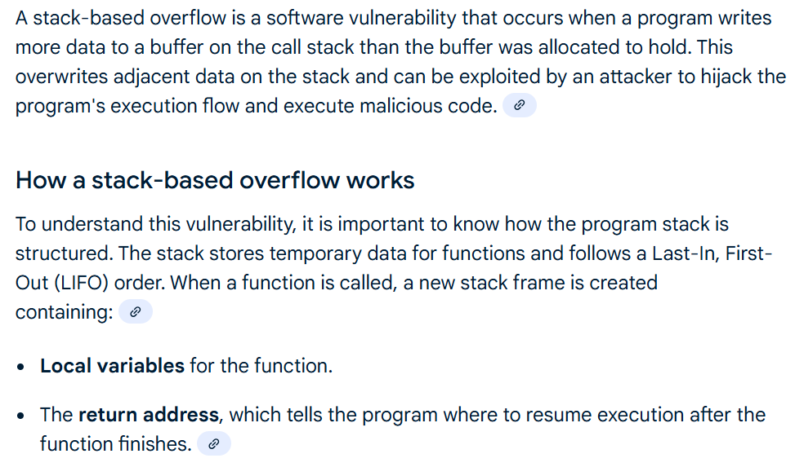
Stack-based Overflow

Slide 18
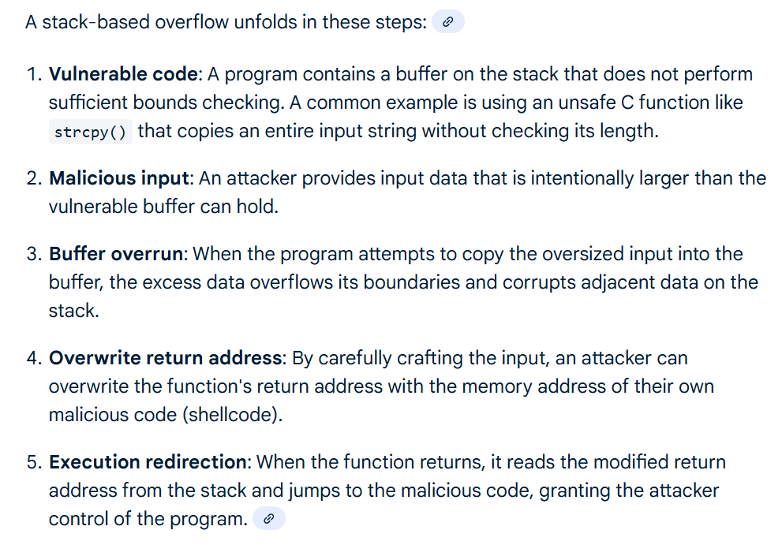

Slide 19
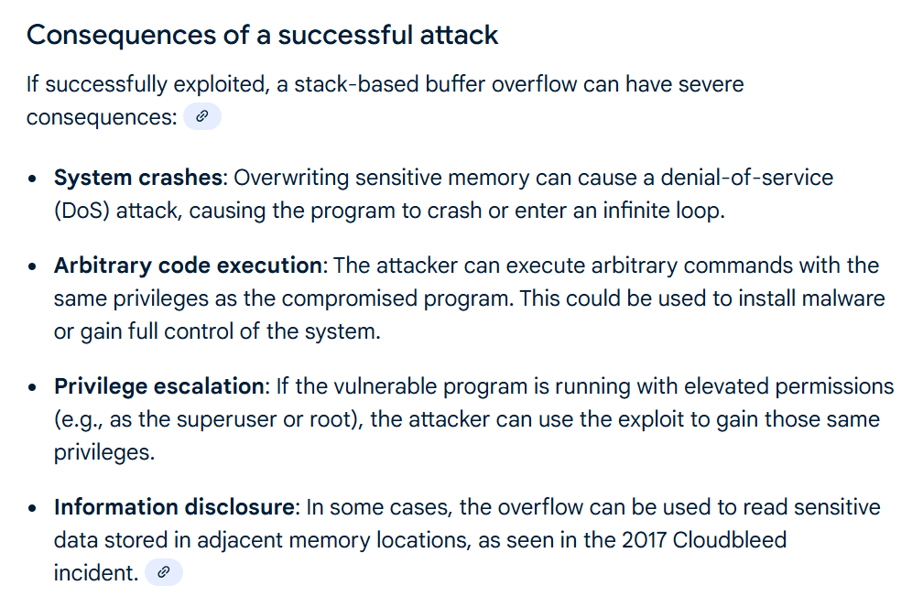

Slide 20
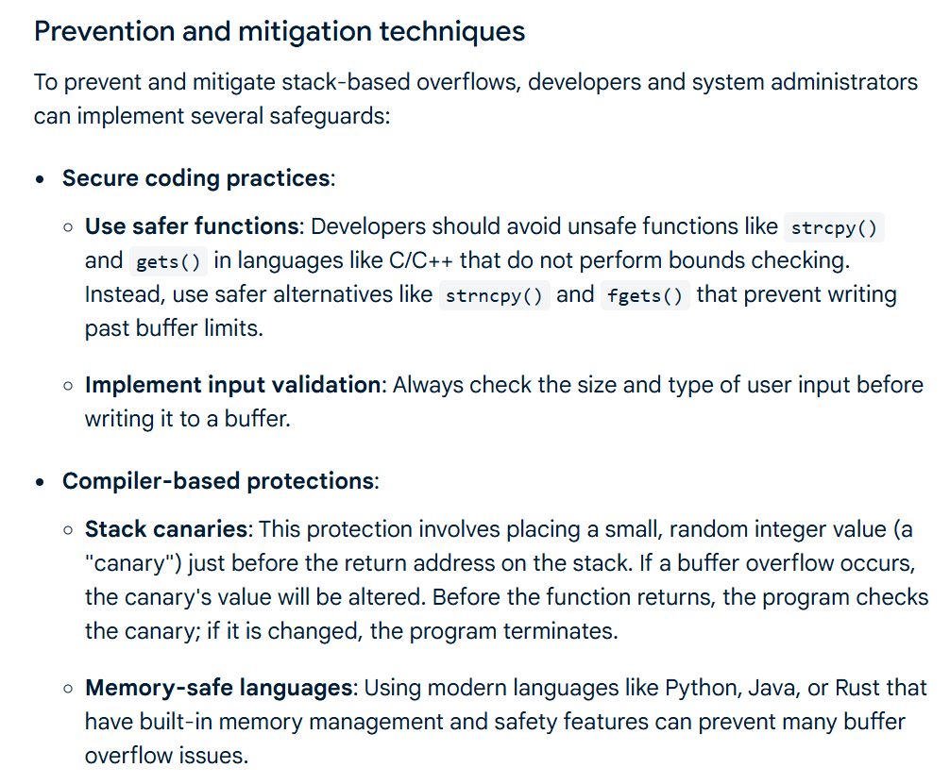

Slide 21
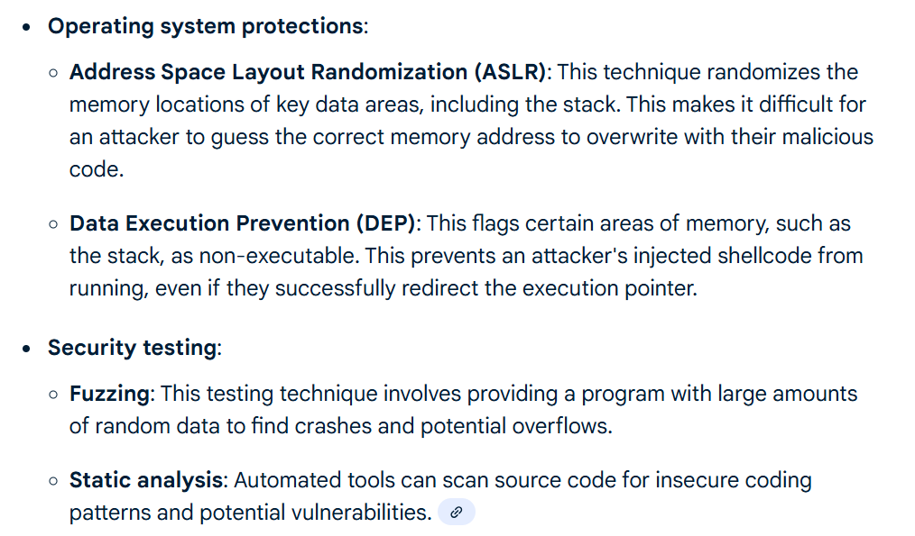

Slide 22
Heap-based overflow
A heap overflow is a memory corruption vulnerability that occurs when a program writes more data to a dynamically allocated memory block than it was designed to hold. The "heap" is an area of memory used for dynamic memory allocation, where objects and data are created and destroyed at arbitrary times during a program's execution.
Unlike a stack overflow, which involves local variables and function call data, a heap overflow involves data structures that are created with functions like malloc() or new. If a program does not perform proper boundary checks on data being copied into a heap buffer, it can overwrite data in adjacent memory blocks.
In a heap-based buffer overflow, an attacker can overwrite buffers that are stored on the heap. Whenever malloc() or its relatives are called in C to allocate memory, a fixed-size buffer allocated on the heap is returned. While such buffers can be reallocated to be larger in size, a
call to a function such as realloc() must take place. Between the time that malloc() and
realloc() are called, the buffer is of a fixed size. During that time, an attacker can attempt to
feed user input into that buffer and overwrite data on the heap that is adjacent to the buffer.

Slide 23
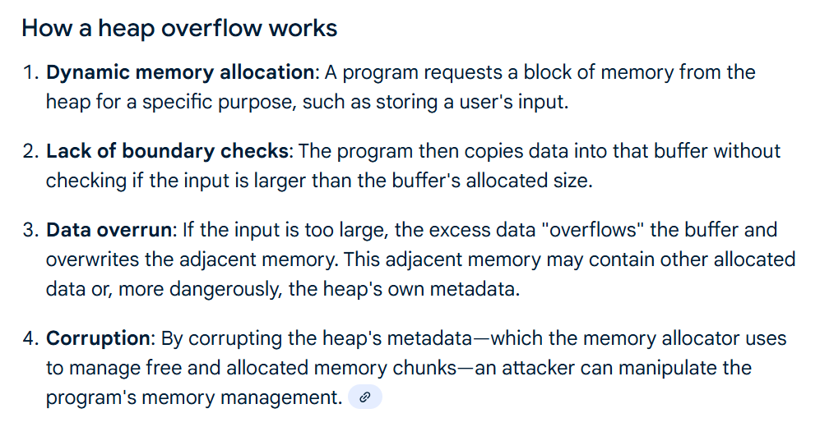

Slide 24
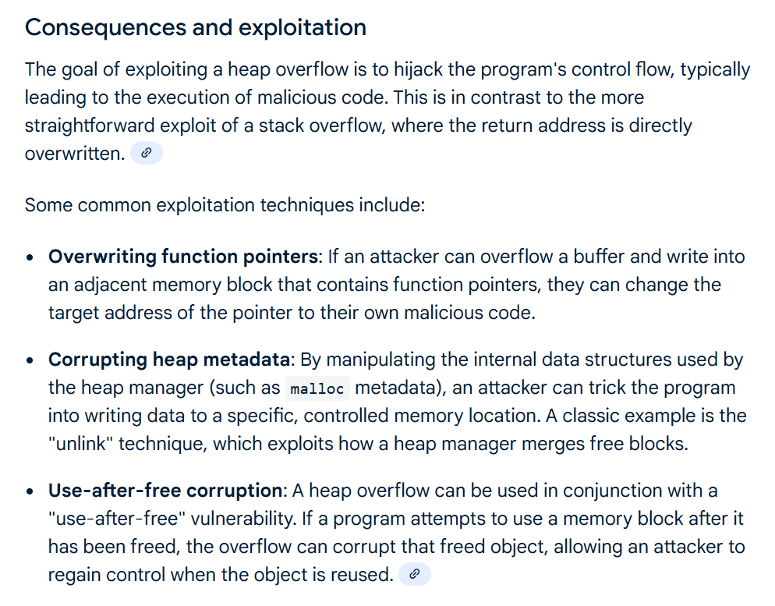

Slide 25
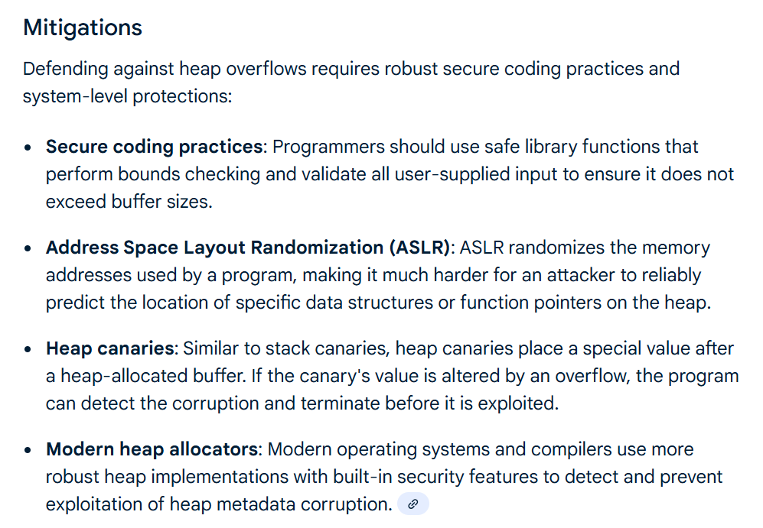

Slide 26
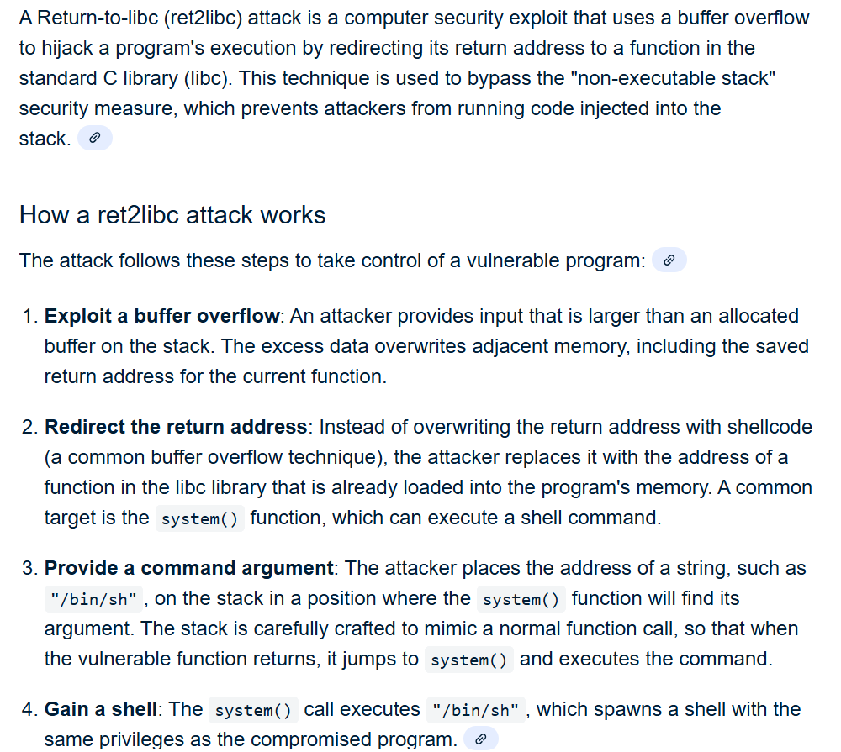
Ret2libc attack

Slide 27
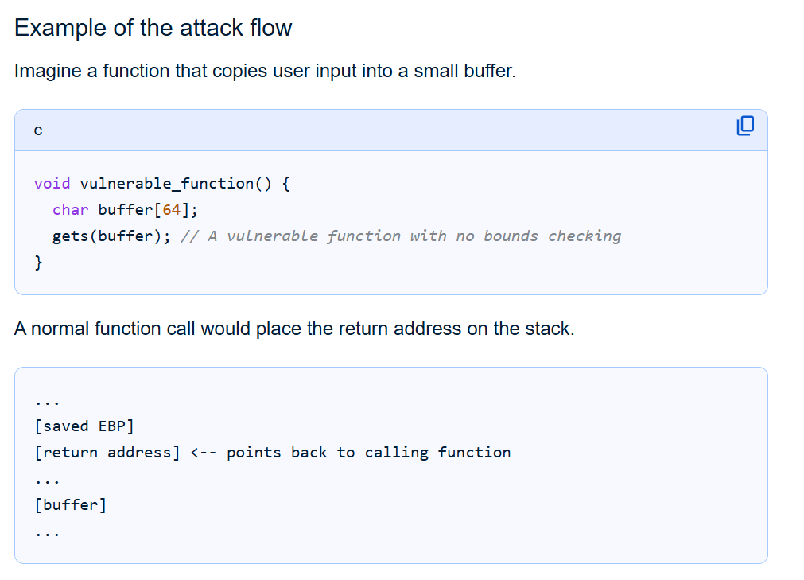

Slide 28
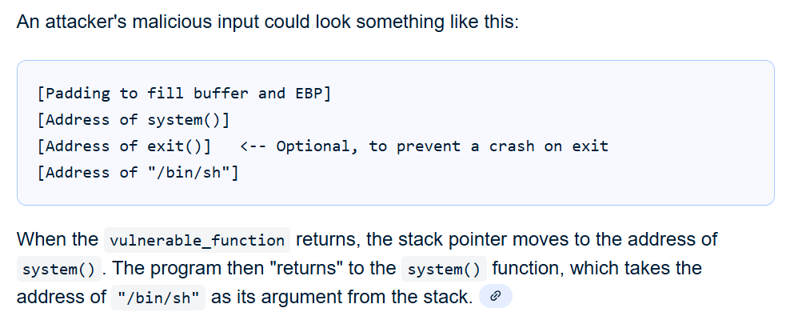

Slide 29
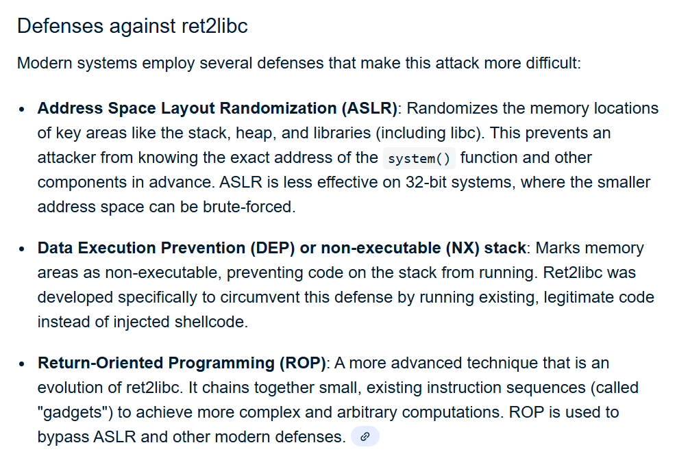

Slide 30
StackGuard
StackGuard is a compiler technique developed by Crispin Cowan. StackGuard inserts a “canary” just before the return address on the stack, and some additional code that checks that the canary is not corrupted just before a function returns. Microsoft has also incorporated a similar canary-like feature in its C++ compiler, which can be enabled by compiling with a /GS flag on the compiler’s command line.
The StackGuard canary approach only works, of course, if the attacker cannot predict
what the canary will be. If the canary were a fixed value, the attacker could simply rewrite the
fixed value, and follow it by the return address of his choice. Instead, the canary value is chosen
to be a random value, unpredictable to an attacker.
If the canary has been modified, then it means that an attacker might be trying to overflow
a buffer. In response to a corrupt canary, the code could halt the program to prevent an
attacker from gaining control of the program.

Slide 31
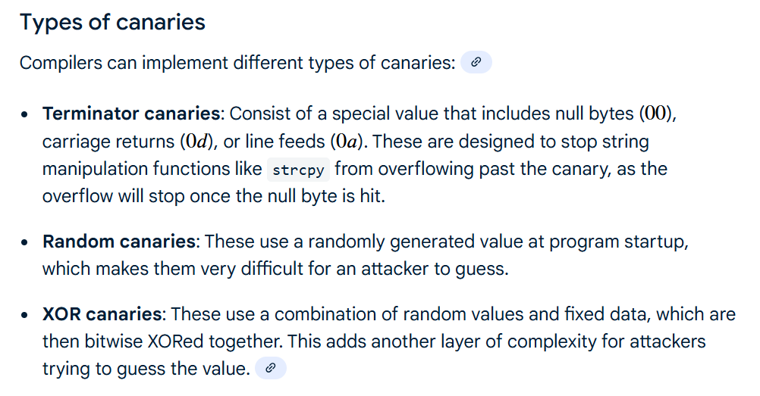

Slide 32
Static analysis tools
Static analysis is a type of analysis that can be done to programs without running them.
With respect to security, there are various types of checks that are interesting for a static analysis tool to conduct. For instance, when a function receives input from a caller, that input can be considered “tainted” until it is checked (to make sure that it is not null, or that it has been
sanitized by a “check” function prior to further use). Very often, compilers have all the mechanisms required to do such checks, but do not have the specific knowledge of what types of static analysis checks make sense for an application.
Dawson Engler’s research group at Stanford University identified the opportunity to do
meta-level compilation, in which compilers can be extended with declarations that give them
such knowledge, and can be used to find security as well as other types of bugs (Engler et al.
2000). Meta-level compilation can also detect frequent patterns and idioms used in code, and
report a warning or error when some anomalous part of the code does not follow the pattern,
possibly indicating a bug. Synchronization and memory bugs, in addition to security bugs,
can be found using static analysis.

Slide 33
Thank you
Dr. Rachaita Dutta
Assistant professor
Dept. of mca
  9007223301
  rachaitadutta@my.amrita.edu

